Slide 1
Recommender systems-part 1
Marziyeh Mousavi
Introduction to datascience
Fall 2024

Slide 2
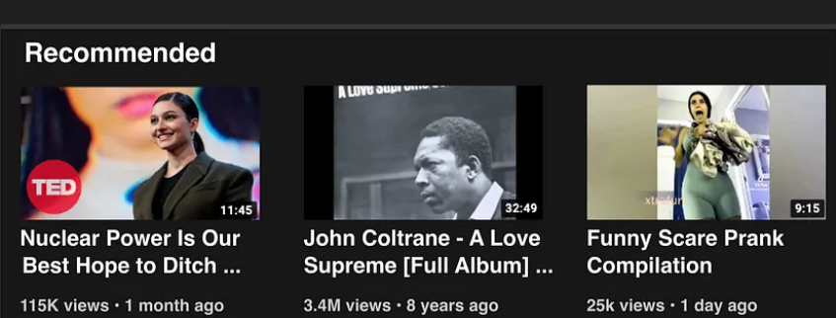
Recommender systems
Recommender systems are algorithms providing personalized suggestions for items that are most relevant to each user. With the massive growth of available online contents, users have been inundated with choices. It is therefore crucial for web platforms to offer recommendations of items to each user, in order to increase user satisfaction and engagement.
Image from towards datascience

Slide 3
Component Procedures of a Recommender:
Candidate Generations: This method is responsible for generating smaller subsets of candidates to recommend to a user, given a huge pool of thousands of items.
Scoring Systems: Candidate Generations can be done by different Generators, so, we need to standardize everything and try to assign a score to each of the items in the subsets. This is done by the Scoring system.
Re-Ranking Systems: After the scoring is done, along with it the system takes into account other additional constraints to produce the final rankings.

Slide 4
Manual Curation
Before the internet, when you needed book recommendations you would go to the library, where a librarian was available to suggest books that were relevant to your interests or similar to books you liked.
But this method doesn’t scale particularly well, and it’s limited by your personal knowledge and imagination. (Not that I’m suggesting that your personal knowledge and imagination are limited.) So let’s think about what we can do with data.

Slide 5
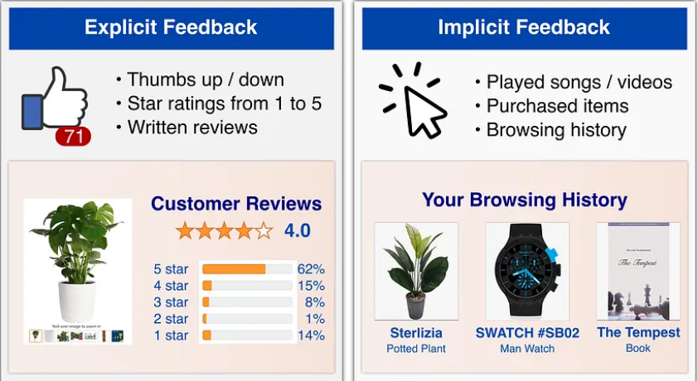
Explicit Feedback vs. Implicit Feedback
In recommender systems, machine learning models are used to predict the rating rᵤᵢ of a user u on an item i. At inference time, we recommend to each user u the items l having highest predicted rating rᵤᵢ.

Slide 6
Explicit Feedback vs. Implicit Feedback
We therefore need to collect user feedback, so that we can have a ground truth for training and evaluating our models. An important distinction has to be made here between explicit feedback and implicit feedback

Slide 7
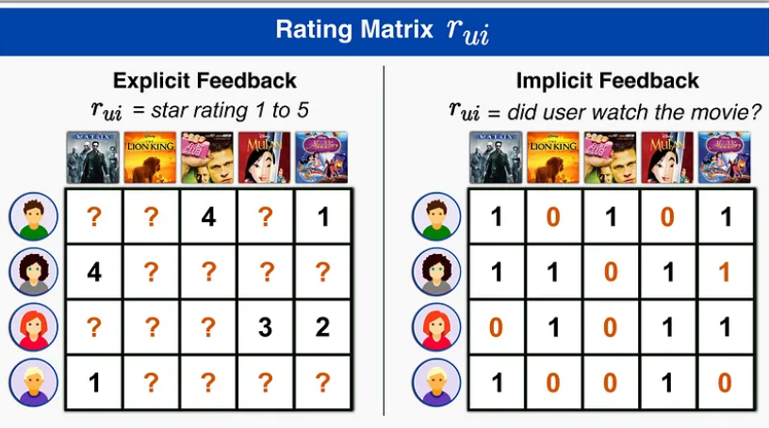
Explicit Feedback vs. Implicit Feedback
Explicit feedback is a rating explicitly given by the user to express their satisfaction with an item. Examples are: number of stars on a scale from 1 to 5 given after buying a product, thumb up/down given after watching a video, etc. This feedback provides detailed information on how much a user liked an item, but it is hard to collect as most users typically don’t write reviews or give explicit ratings for each item they purchase.

Slide 8
Explicit Feedback vs. Implicit Feedback
Implicit feedback, on the other hand, assume that user-item interactions are an indication of preferences. Examples are: purchases/browsing history of a user, list of songs played by a user, etc. This feedback is extremely abundant, but at the same time it is less detailed and more noisy (e.g. someone may buy a product as a present for someone else). However, this noise becomes negligible when compared to the sheer size of available data of this kind, and most modern Recommender Systems tend to rely on implicit feedback.

Slide 9
Explicit Feedback vs. Implicit Feedback
Once we have collected explicit or implicit feedbacks, we can create the user-item rating matrix rᵤᵢ. For explicit feedback, each entry in rᵤᵢ is a numerical value—e.g. rᵤᵢ = “stars given by u to movie i”—or “?” if user u did not rate item i. For implicit feedback, the values in rᵤᵢ are a boolean values representing presence or lack of interaction—e.g. rᵤᵢ = “did user u watch movie i?”. Notice that the matrix rᵤᵢ is very sparse, as users interact with few items among all available contents, and they review even fewer items!

Slide 10
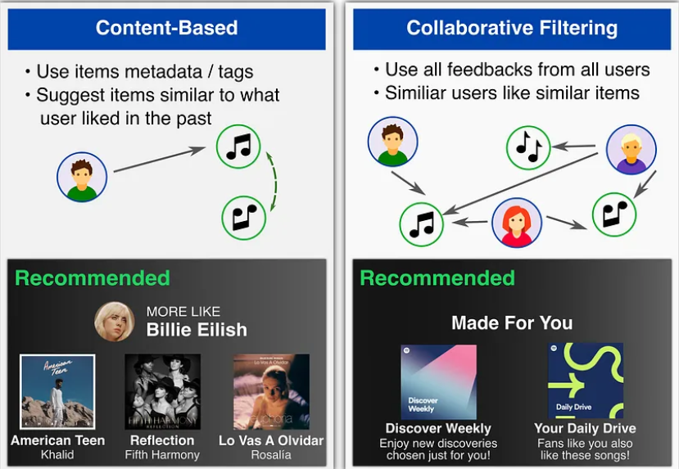
Content-Based vs. Collaborative Filtering Approaches
Recommender system can be classified according to the kind of information used to predict user preferences as Content-Based or Collaborative Filtering.

Slide 11
Content-Based
Content-based filtering system: Content-Based recommender system tries to guess the features or behavior of a user given the item’s features, he/she reacts positively to.

Slide 12
Content-Based
Content-based methods describe users and items by their known metadata. Each item i is represented by a set of relevant tags—e.g. movies of the IMDb platform can be tagged as“action”, “comedy”, etc. Each user u is represented by a user profile, which can created from known user information—e.g. sex and age—or from the user’s past activity.

Slide 13
Content-Based
The advantage of this approach is that items metadata are known in advance, so we can also apply it to Cold-Start scenarios where a new item or user is added to the platform and we don’t have user-item interactions to train our model. The disadvantages are that we don’t use the full set of known user-item interactions (each user is treated independently), and that we need to know metadata information for each item and user.

Slide 14
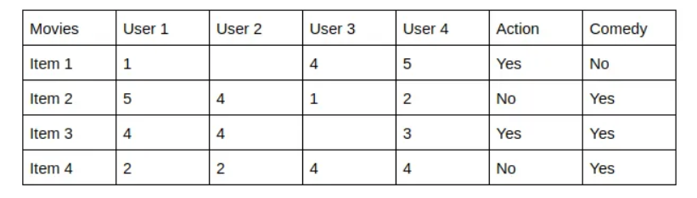
Content-Based-example
The last two columns Action and Comedy Describe the Genres of the movies. Now, given these genres, we can know which users like which genre, as a result, we can obtain features corresponding to that particular user, depending on how he/she reacts to movies of that genre.

Slide 15
Content-Based-example
Once, we know the likings of the user we can embed him/her in an embedding space using the feature vector generated and recommend him/her according to his/her choice. During recommendation, the similarity metrics (We will talk about it in a bit) are calculated from the item’s feature vectors and the user’s preferred feature vectors from his/her previous records. Then, the top few are recommended.

Slide 16
Collaborative Filtering
Collaborative filtering methods do not use item or user metadata, but try instead to leverage the feedbacks or activity history of all users in order to predict the rating of a user on a given item by inferring interdependencies between users and items from the observed activities.

Slide 17
Collaborative Filtering
The advantage of this approach is that the whole set of user-item interactions (i.e. the matrix rᵤᵢ) is used, which typically allows to obtain higher accuracy than using Content-Based models. The disadvantage of this approach is that it requires to have a few user interactions before the model can be fitted.

Slide 18
Item-Based Collaborative Filtering
Item-item collaborative filtering is one kind of recommendation method which looks for similar items based on the items users have already liked or positively interacted with. It was developed by Amazon in 1998 and plays a great role in Amazon’s success.

Slide 19
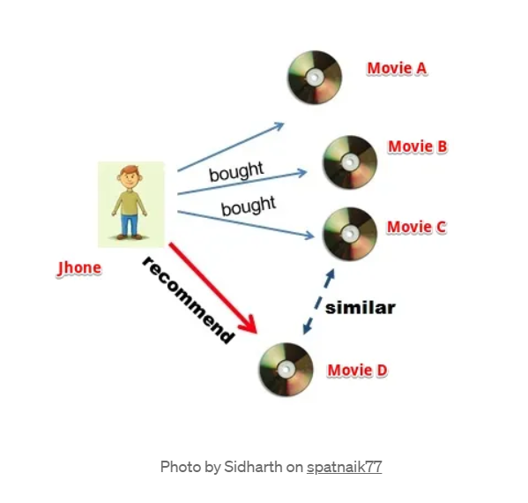
Item-Based Collaborative Filtering
How IBCF works are that it suggests an item based on items the user has previously consumed. It looks for the items the user has consumed then it finds other items similar to consumed items and recommends accordingly.

Slide 20
Item-Based Collaborative Filtering-example
Suppose our user Jhone wants to purchase a movie DVD. Our job is to recommend him a movie based on his past preferences. We will first search for movies that Jhone has watched or liked, let’s call those movies ‘A’, ‘B’ and ‘C’.

Slide 21
Item-Based Collaborative Filtering-example
Next, we will search for other movies similar to three movies. Suppose we found out that movie ‘D’ is highly similar to ‘C’, therefore, there is a highly likely chance that Jhone will also like movie ‘D’ because it is similar to one Jhone has already liked. Hence, we will suggest the movie ‘D’ to Jhone.

Slide 22
Item-Based Collaborative Filtering-Finding Similarity Between Items
So at its core IBCF is all about finding items similar to the ones user has already liked. But how to find similar items? and what if there are multiple similar items in that case which item to suggest first? To understand this lets’ first understand the intuition behind the process, this will assist us to comprehend the mathematics behind the IBCF recommendation filtering.

Slide 23
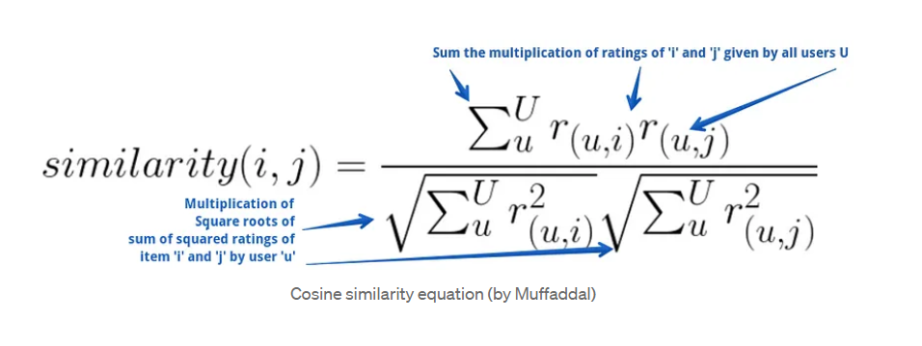
Item-Based Collaborative Filtering-Finding Similarity Between Items
We will use cosine similarity.
The formula is:

Slide 24
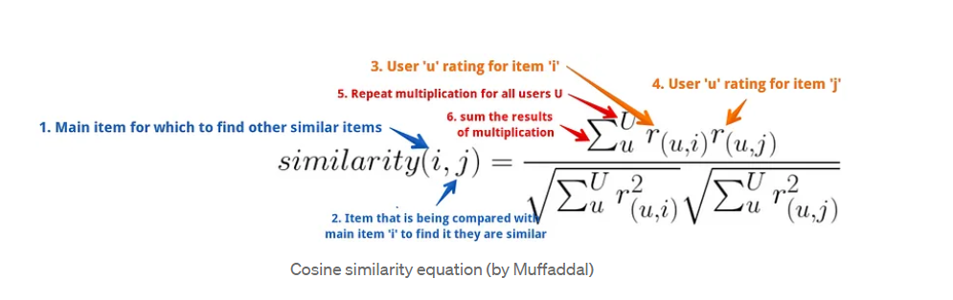
Item-Based Collaborative Filtering-Finding Similarity Between Items
The better explained formula is:

Slide 25
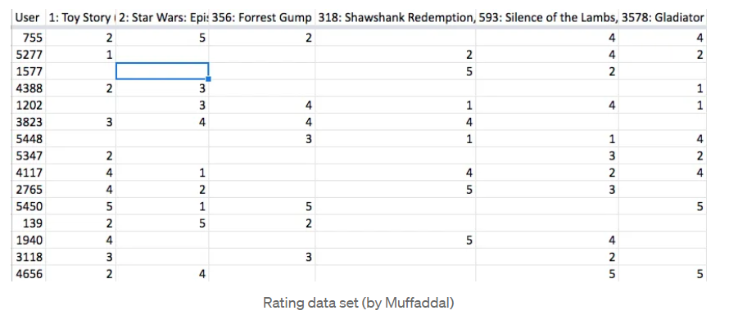
Item-Based Collaborative Filtering-Finding Similarity Between Items-example
Suppose we have a table of users and their ratings for movies.

Slide 26
Item-Based Collaborative Filtering-Finding Similarity Between Items-example
Let’s pick two movies (Id 1: Toy Story and Id 2: Star Wars) for which we have to calculate the similarity i.e. how much these two movies are comparable to one another in terms of their likeness by users. To compute this we will:

Slide 27
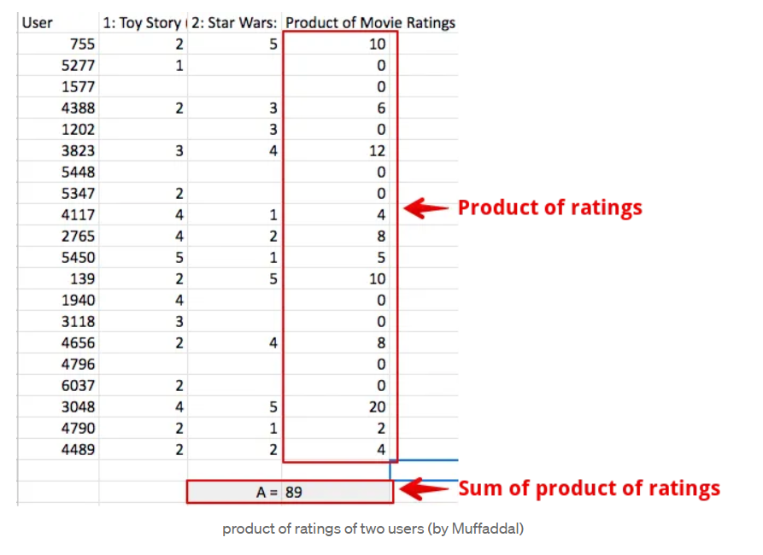
Item-Based Collaborative Filtering-Finding Similarity Between Items-example
First multiple ratings of both movies with each other and the sum of the result. Let’s call this value ‘A’.

Slide 28
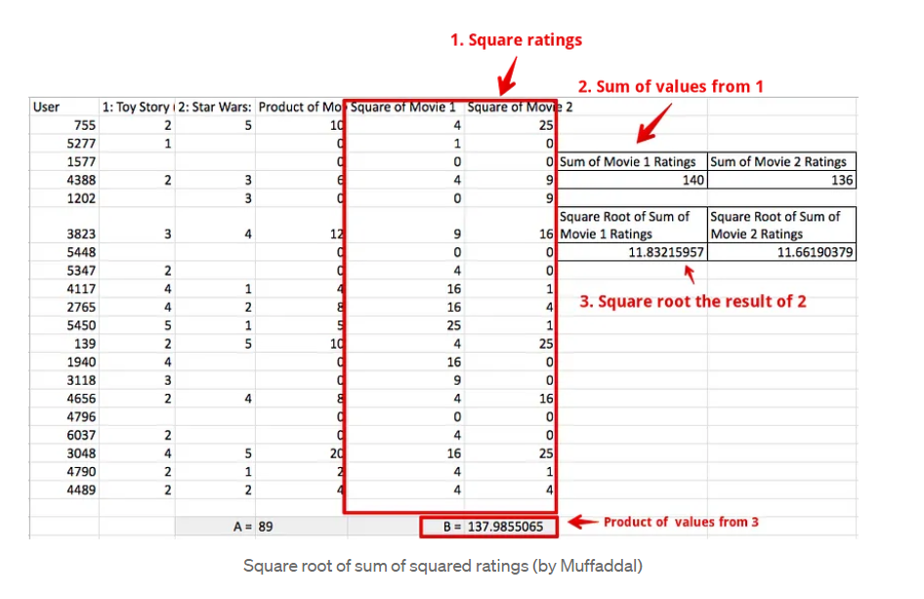
Item-Based Collaborative Filtering-Finding Similarity Between Items-example
Second, we‘ll sum the squared movie ratings and then take the square root of them. So square all movie 1 ratings, sum them and then take the square root to get the final value (do the same for movie 2). Doing so will get us two values i.e. square root value of movie 1 and movie 2. Multiply both values. We call this final value ‘B’

Slide 29
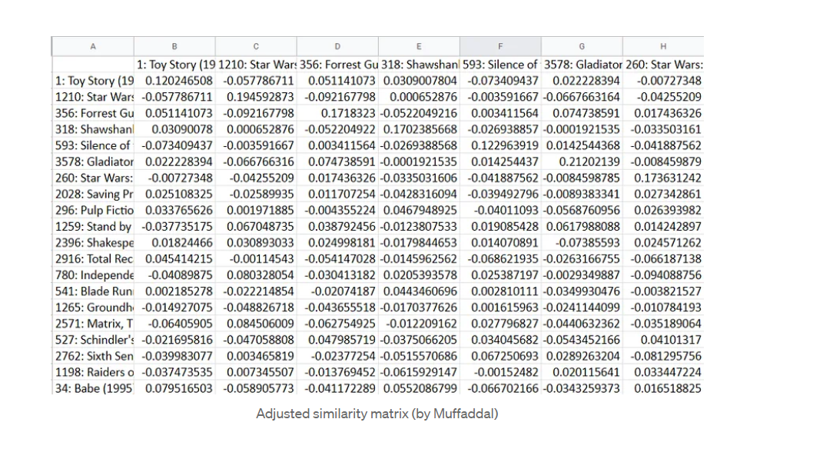
Item-Based Collaborative Filtering-Finding Similarity Between Items-example
If we calculate similarity score for all ,we have:

Slide 30
Item-Based Collaborative Filtering-Calculate Recommendation Scoring
A table of similar items is a half job done. We know which items are comparable but we have yet to crack the nut on which items to recommend to users from the list of similar items. For this will have to combine our similarity matrix with users' past history of rated items to generate a recommendation. This is easily achieved by applying IBCF’s equation.

Slide 31
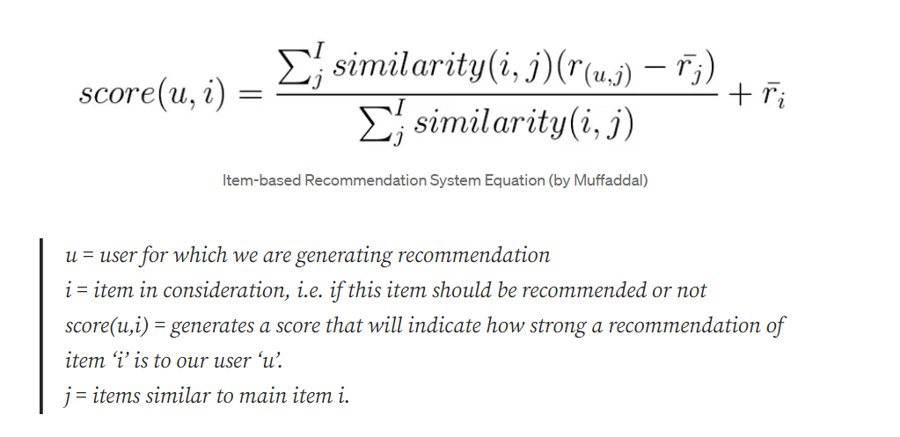
Item-Based Collaborative Filtering-Calculate Recommendation Scoring
The formula is:

Slide 32
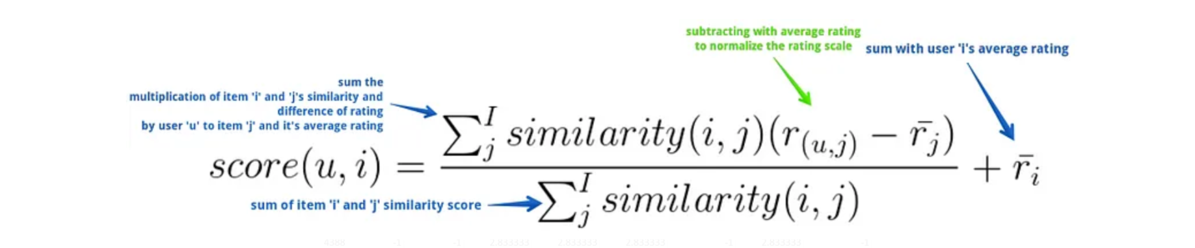
Item-Based Collaborative Filtering-Calculate Recommendation Scoring
The better explained formula is:

Slide 33
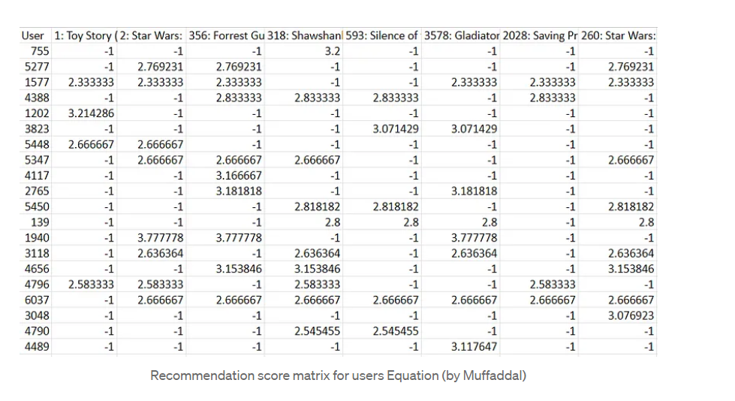
Item-Based Collaborative Filtering-Calculate Recommendation Scoring
Doing so will generate a matrix of scores for users and available items. Top-scored items can be recommended to the user.

